Slide 1
Constitutive Promoters
Notes:
The most basic type of promoter you can have in a prokaryote are constitutive promoters. These promoters initiate mRNA synthesis independent of the influence of regulation. The term ‘constititive expression’ is more commonly defined as ‘Expression of a gene that is transcribed at a constant level’. This idea of ‘constant’ expression turns out to be a very fuzzy concept that our field still grapples with. In practice, transcription rates depend highly on the physiology of the cell, and thus in practice one never observes true ‘constant’ or even ‘consistent’ expression. Thus, I’ll give it a more concrete but specific biochemistry-based definition – a constitutive promoter is one whose observed states only include free and sigma-factor-bound species.

Slide 2
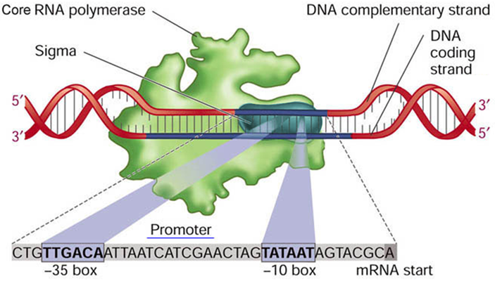
Transcription in bacteria
Notes:
In E. coli, the DNA encoding a constitutive promoter is a pattern composed of two patches of sequence called the -10 box and -35 box. The numbers -10 and -35 are positions of the centers of the two boxes relative to the transcriptional start site. The RNA polymerase recognizes these patches and intitiates a new mRNA molecule beginning at the transcriptional start site. The E. coli core RNA Polymerase is an enzyme composed of 5 polypeptide subunits in a stable complex. Additional proteins, called sigma factors are the adaptors that match up the polymerase with its promoters. A sigma factor is shown in Teal in this figure. The most common sigma factor in E. coli is sigma 70, and this pattern of -10 and -35 boxes is specific to this sigma factor.

Slide 3
Transcription in bacteria
Central metabolism and the central dogma are universally conserved at least between prokaryotes
Transcriptional control mechanisms aren’t at all
Notes:
Different sigma factors have different sequence specificities. Some processes in the cell like central metabolism and the mechanisms for syntheses of proteins and mRNAs are universally conserved amongst prokaryotes. However, the mechanisms of transcriptional initiation are highly variant. Different organisms use different sequences to initiate transcription.

Slide 4
Alternate sigma factors in E. coli
σ70 (RpoD) - "housekeeping" sigma factor, transcribes most genes in growing cells
σ54 (RpoN) - nitrogen-limitation sigma factor
σ38 (RpoS) - starvation/stationary phase sigma factor
σ32 (RpoH) - heat shock sigma factor
σ28 (RpoF) - the flagellar sigma factor
σ24 (RpoE) - the extracytoplasmic/extreme heat stress sigma factor
σ19 (FecI) - the ferric citrate sigma factor
Notes:
Though there is only one core RNA polymerase species in E. coli, there are seven sigma factors in the cell. They recognize different DNA sequences and thus recognize different promoters in the cell. Sigma 70 regulates most central dogma genes, and the others are specific to other processes. For example, the sigma28-dependent promoters all control genes associated with biosynthesizing flagella. Other prokaryotes have more sigma factors than E. coli, or just a different set of orthologs. Thus, the vocabulary of promoter types isn’t the same in all bacteria.

Slide 5
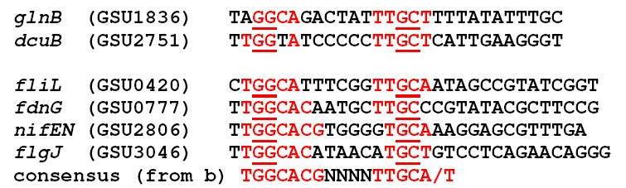
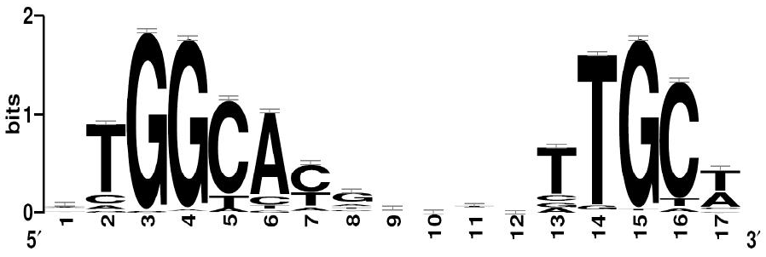
Other sigma factor sites
Example: Geobacter sulfurreducens RpoN-dependent genes
An alternative sigma factor without -10 and -35 consensus sequences
-24
-12
+1
PMID 19624843
Notes:
For example, the RpoN-dependent promoters in Geobacter have a very different recognition sequence than E. coli’s sigma70 promoters. E. coli also has an RpoN homolog called sigma54 that plays similar biological roles to RpoN in Geobacter. Again there are two boxes, but they are located closer to each other and emphasize different bases at a fewer number of sites. The most dominant pattern is a pair of two Gs at -24 and a GC at -12.

Slide 6
The J23100 series
XbaI -35 NheI TCAGTAvrII -10 T NheI T SpeI . RBS – GFP - Term
tctagagNTNANNGCTAGCTCAGTCCTAGGNANNNTGCTAGCTACTAGT
Notes:
Families of simple promoters that respond to a specific type of sigma factor can be generated randomly in the lab. In this experiment we did with Berkeley iGEM in 2006, a family of constitutive sigma 70 promoters was generated combinatorially. We designed a library in which BioBrick restriction sites were flanked by a polylinker of NheI and AvrII sites, a few constant bases such as the TCAGT stretch in black, then mostly random sequence at the -35 and -10 positions. We chose this spacing to make the transcriptional start site be comparable to other popular promoter parts in the Registry. Note that there is nothing ‘promoterish’ about this sequence except for the positioning of the random bases. The DNAs were inserted into a plasmid upstream of an RBS-RFP-terminator cassette.

Slide 7
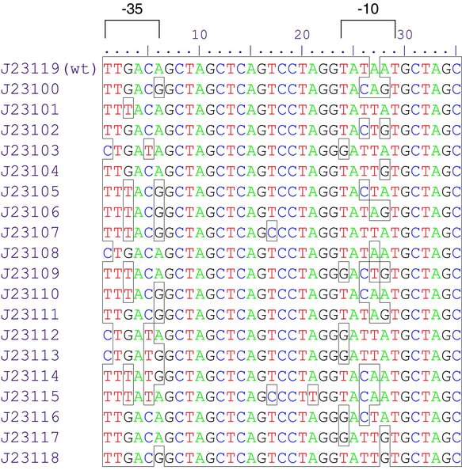
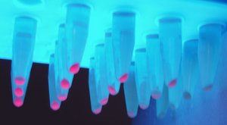
The J23100 series
XbaI -35 NheI TCAGTAvrII -10 T NheI T SpeI . RBS – GFP - Term
tctagagNTNANNGCTAGCTCAGTCCTAGGNANNNTGCTAGCTACTAGT
Notes:
Individual colonies were picked and their fluorescense measured. Stronger promoters would have higher fluorescence due to increased production of RFP. From those hits a set of 19 promoters varying across two orders of magnitude of intensity were identified and are referred to as the J23100 series or Anderson promoter library. It is not challenging to find sigma70 promoters in libraries like this, and libraries like this generate the same scope of diversity that is found amongst natural promoters. The stongest of these promoters is as strong as the strongest endogenous sigma70-dependent promoters. Thus, there is nothing more to a sigma70 promoter than being specific sequences spaced at particular positions relative to a common start site. Further studies on these promoters have revealed that indeed they are fairly consistent in their relative expression across growth conditions and independent of downstream genes. This has led to the exploration of quantitative methods for predicting what promoters to use in an experiment, and we’ll revisit this in another section.

Slide 8
Relative Promoter Units
PMID 19298678
Notes:
Relative Promoter Units is one strategy for encapsulating the strength of a promoter.

Slide 9
Encapsulation of Promoter Activity
{
“name” : “J23100”,
“sequence” : “ttgacggctagctcagtcctaggtacagtgctagc”,
“function” : {
“type” : “prokaryotic_promoter”,
“sigma” : “sigma70”,
“strength” : 74
}
}
Notes:
Encapsulation is the attachment of formal properties to a DNA sequence. This is the essence of the ‘part’ concept, but it is still not entirely clear what information should be captured about a sequence and how it should be measured. Here is an example of what it might look like: the name and sequence of the part is shown in orange, and an object describing its function is shown in blue. We are stating that the promoter is for use in prokaryotes, so all bets are off if you try to put this in eukaryotes, that it relies on sigma70, and its strength is 74. This model of a promoter will be sufficient for the way it is conceived in this paper about RPUs, but let’s first point out some of the limitations of it. First, it only makes a concrete reference to a specific sigma factor. We don’t know that sigma factors from different bacteria would all interact with this promoter in the same way, and we also don’t know that it won’t react with other sigma factors present in the system. The idea that it’s strength can be reduced to a single number is also unclear, but regardless we know that promoters don’t always display the same activity, so we can’t interpret that number simply as meaning, say, that 74 mRNAs will be produced per unit time in the cell. That number will have to be interpreted according to some more complicated model.

Slide 10
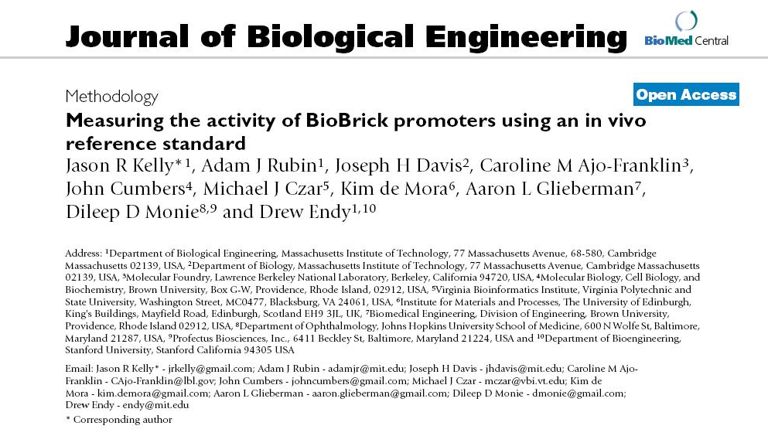
Notes:
In this paper by Endy and coworkers, they describe a means of measuring ‘promoter strength’ that can be interpreted according to a simple transcription model that allows them to predict relative transcription rates.

Slide 11
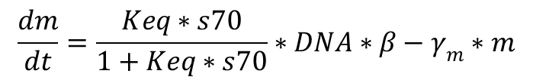
Mathematical Explanation
State: free
Nothing happening
State: sigma bound
fraction bound
degradation
RNAP
$$\frac{dm}{dt}=\frac{Keq∗s70}{1+Keq∗s70}∗DNA∗β−γ_{m}∗m$$
σ70
Transcription
Notes:
The paper derives a basis for RPU based on other models of transcription and translation. The paper does this derivation slightly differently, but the gist is the same. I have defined a constitutive promoter as one that only interacts with a sigma factor. Thus, that promoter exists in two states in the cell: one that is free and thus inactive, and one that has recruited an RNA polymerase by binding to a sigma factor and is thus active and producing mRNAs at some rate beta. *click* I can thus express the rate of transcription as the fraction of DNAs that are in this sigma-bound state multiplied by beta and the number of DNAs present.

Slide 12
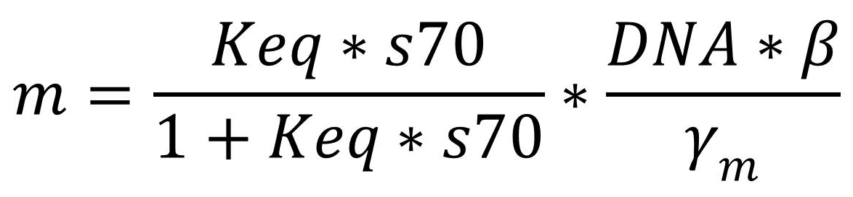
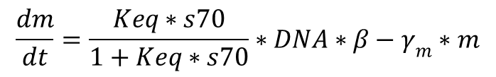
Mathematical Explanation
$$\frac{dm}{dt}=\frac{Keq∗s70}{1+Keq∗s70}∗DNA∗β−γ_{m}∗m$$
Steady-state assumption (dm/dt = 0)
vs
Notes:
If I make a steady state assumption, then I can solve for ‘m’ as a function of the other terms. *click* Consider we have two different cells that differ only in terms of which constitutive promoter is upstream of a reporter gene. In the two constructs, the sequence of the mRNA is the same, so presumably all aspects of translation is the same. The only thing that differs is a few positions in the two promoters and thus the amount of mRNA that will get produced. If we want to predict absolute concentrations of m, we’d need to know how many available sigma70’s there were, their Keq for the promoter, the concentration of the DNA, the degradation rate of the mRNA, and the rate beta at which an mRNA gets produced for sigma-bound complexes. The trouble with this is that the s70 and beta terms depend heavily on the state of the cell and the environmental conditions. In practice, we do not have any models that can deal with absolute rates right now. However, if instead we wish to predict the ratio of two mRNAs, our task is easier. So, we are talking about taking the ratio of two of these equations. We know that subtle things like a few positions in a promoter rarely affect DNA concentrations, so in the ratio, DNAs will *click* cancel out. Similarly, the sequence of the mRNA and the type of sigma factor and its relationship to the RNAP are the same between the two, so the beta term and gamma terms *click* cancel out. The only terms that survive deal with the concentration of sigma factor and its affinity for the promoter. Since we are talking about the same sigma factor in both cases, this all reduces down to a single variable that is a binding constant, which is different for the two promoters. If I assume that sigma70 concentrations are far from saturating, then this all simplifies to saying that m is proportional to the binding constant, and ratios of activity are ratios of binding constants.

Slide 13
Relative Promoter Units
1
Standard Promoter: J23101
0.05
2
4
7
8
12
Notes:
If all those simplifying assumptions hold true, then you should be able to define one promoter sequence as a standard, and in their study they define this standard to be the promoter part J23101. By measuring activity of other promoters relative to this standard, you should be able to predict relative transcription rates between two promoters in different contexts.

Slide 14
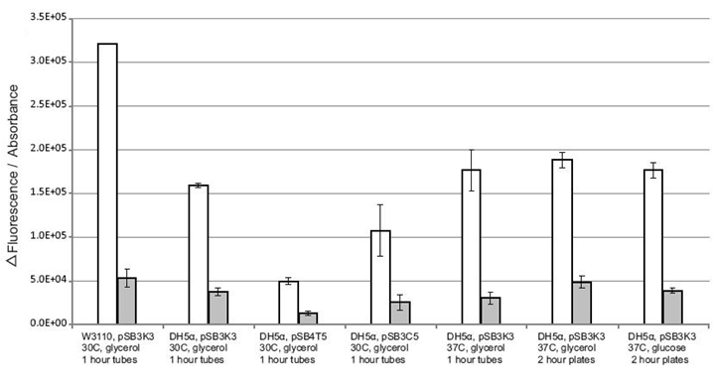
Variation in expression levels
BBa_J23101 and BBa_J23150, two constitutive promoters
Watching promoters driving GFP
Signals were sensitive to the choice of strain, origins, and antibiotic markers
But insensitive to temperature and carbon source
Notes:
In this experiment, they are doing pairwise comparisons of the relative fluorescence of promoter-GFP constructs. In each condition, the white bar is J23101, and the grey bar is J23150. The different conditions are different plasmid backbones with different copy numbers and different temperatures and different incubation times. Though the different conditions all give different absolute levels, the ratio for the two promoters is invariant indicating that our assumptions hold true at least for constitutive promoters driving GFP.

Slide 15
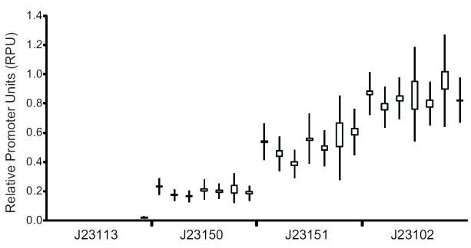
Relative Promoter Units
Notes:
They also demonstrate that the measurement of RPU is invariant across measurement techniques such as cytometry versus bulk fluorescence. It is also independent of what lab did the measurment.
This concept of RPU is still a very new idea, and there are few examples to expose fully where it works and where it doesn’t. One situation where it definitely falls apart is when the things you add to the cell affect the physiology of the cell. For example, if you are altering the growth rate of the bacterium, that means you are affecting things like beta and DNA concentrations, and thus the mathematical assumptions we made break down.

Slide 16
Promoters as ‘Parts’
Notes:
Constitutive promoters are great when you just want something simple in your design and aren’t worried about dynamics or toxicity of your proteins. Often, however, you will want some regulation, and for this you’ll need to use more complicated promoters.

Slide 17
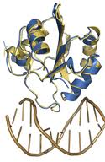
A non-covalent reaction
TF
TF
+
S
S
Non-Covalent Reaction
Notes:
When we discussed constitutive promoters, we said that they exist in two states, one in which sigma factor is bound and one in which it is not. In non-constitutive promoters, additional proteins called transcription factors will can bind to the DNA creating more potential states.

Slide 18
Designing with promoters
Can extract complex promoters and TFs from natural systems and use them in new contexts
Protein engineering / Promoter engineering can give you new sensor parts
araB
araA
araD
ParaBad
insulin
ParaBad
Notes:
One of the most commonly-used promoters is the Pbad promoter. This promoter binds to a transcription factor called AraC in two different configurations that depend on whether or not AraC is bound to the small molecule arabinose. Only one of those states will bind sigma70 and promote transcription. The result is that this promoter only turns on when arabinose is present. Thus, you can turn genes on and off by adding a small molecule to the cells. The Pbad promoter part came from the region of the E. coli chromosome upstream of the arabinose catabolic genes. Though often it is unclear where the boundaries of a part lie, through trial and error you often can identify a snippet of DNA sequence that retains the normal transcription behavior of the genomic copy. You can then use that sequence as a ‘part’ placing it upstream of other genes, such as insulin here. These small-molecule-inducible promoters are particularly useful, but other promoters have been identified that respond to other things. It is also possible to use experiments like those done with the J23100 series to create new promoters that depend on various transcription factors in the cell. You can also engineer proteins that regulate a promoter part to respond to different things.

Slide 19
Designing genetic circuits
(single-input toggle switch)
σ54
NR1
GFP
lacp
araB
lacl
gfp
glnG
cI
glnKp
rpoN
LacI
araBp
RFP
cl
nifHp
cl
nifA
lacl
rfp
cIp
σ54
nifA
University of Michigan – 2007 iGEM
Notes:
Non-consitutive promoters are used ubiquitously in genetic devices. Simple on/off switches are used to keep toxic genes off until its time to test them. For example, if you want to watch the biosynthesis of a terpene like borneol, it will be easiest to study that if you use an inducible promoter to control the genes. This allows you to grow up all your cells to a standard non-induced state, and have a distinct start time for when your pathway began expressing. Also, non-constitutive promoters are required to make the genetic circuits that defined the early years of synthetic biology. These circuits are usually composed exclusively of transcriptional activators, represessors, and the promoter parts they control. Biochemically, there is very little going on in these sytems except transcriptional control.

Slide 20

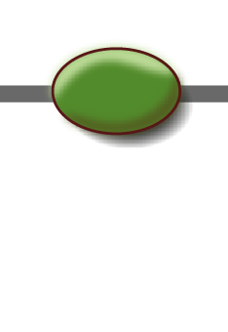


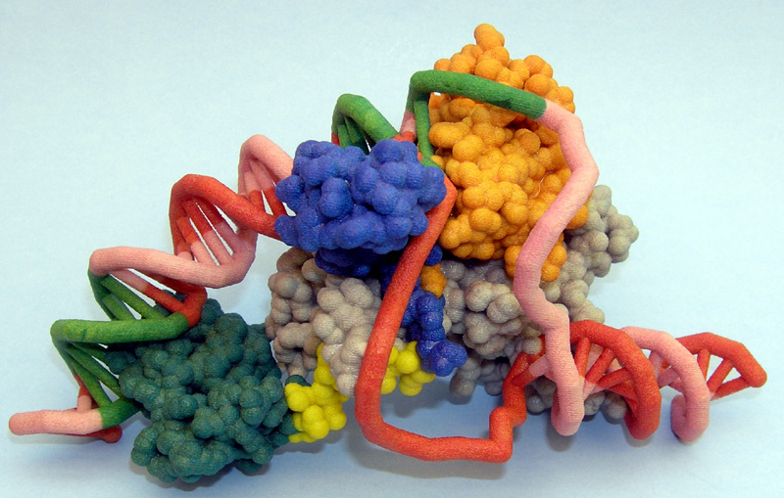
‘Promoters’
Promoter RBS Gene Ter
Notes:
Before we move on, I want to remind you that we are dealing with a chemical system, and we’ll often black box details. In practice, these promoter initiation complexes are complicated shapes obeying the rules of quantum mechanics and we reducing this compexity to simple icons and numbers. It is very easy to forget that the actual structure of transcriptional initiation complexes has many discernible microstates, and we necessarily describe them with far less refinement than physicochemical theories would allow. As a result, it is often necessary to use more phenomenalogical models to describe the behavior of a promoter than physicochemical ones.

Slide 21
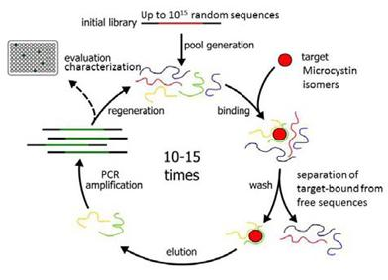
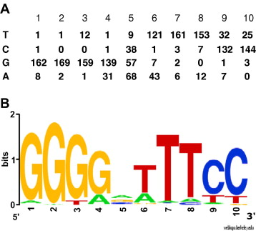
QSAR for a DNA:Protein interaction
Notes:
Like with the sigma factors, transcription factors are really looking for a sequence; they are forming complexes with the DNA in which stabilizing interactions are satisfied. They recognize patterns of DNAs, just as our enzymes recognized patterns of substrates. We can capture this pattern in terms of structure activity relationships, and for DNA-binding, hidden Markov models are the current best-in-class approach. We won’t learn how the algorithms for that work, but DNA binding patterns are more commonly illustrated visually as ‘sequence logos’ which capture the same information as the more quantitative model. These models can be populated by doing experiments such as SELEX. Here, a pool of random DNA sequences is selected by binding to immobilized transcription factor protein, and those sequences that are bound get selectively amplified by PCR. After multiple rounds of enrichment, the surviving DNAs are sequenced, and algorithms can extract the patterns from such data.

Slide 22
The elements of mRNA control
Soluble elements working in trans
Transcription factors
(activators and repressors)
Two-component signal transduction
(Histidine Kinases / Response regulators)
Sigma factors
RNAs
(antisense RNA, riboregulators, siRNA, miRNA, shRNA)
Control elements working in cis
Promoters
Riboswitches
Terminators
Notes:
We often use the terms transcriptional control and translational control. Let me re-phrase transcriptional control in a little more granular form. Outlined here are all the various genetic elements that can affect the amount of an mRNA in direct ways. Some of these, such as transcription factors and sigma factors affect transcription initiation. Others such as riboswitches and antisense RNAs affect the elongation and termination phases of transcription. Small RNAs, and in particular eukaryotic microRNAs, can also affect the posttranscriptional processing of the mRNA. These are examples of post-transcriptional control, but they affect the concentration of mRNA and thus from a modeling standpoint are most usefully considered in the context of transcription control.
From a genetic perspective, we can categorize these control elements as being either cis or trans. A cis element is a separate gene that encodes a protein or RNA that is produced normally. The product of that gene binds to the promoter or mRNA, forms a complex, and changes in mRNA concentrations result. Cis elements are the things necessarily on the same DNA as the gene being regulated. Promoters are upstream of the transcribed sequence and define the start of that sequence. Terminators define the end of the mRNA, and riboswitches exist within the mRNA molecule.

Slide 23
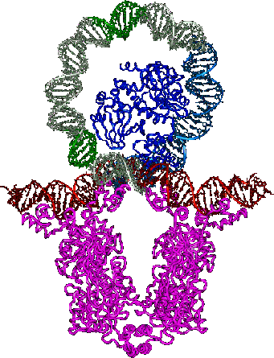
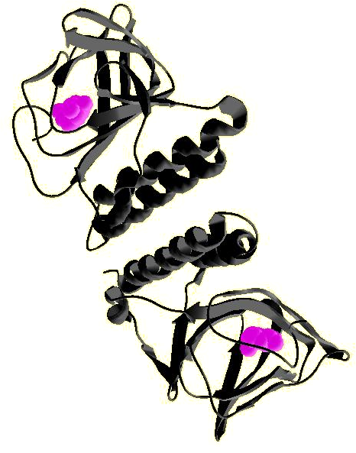
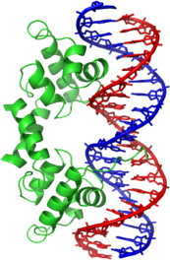
Activation and repression
Transcription factors directly bind DNA and either activate or repress transcription, often bind small molecules too
In prokaryotes, this often involves DNA bending
Eukaryotes have “Mediator”, a large protein complex that acts as the interface between TFs and RNA
polymerase
AraC (arabinose)
Lambda Repressor
Notes:
Transcription factors are usually proteins, and they directly bind to a DNA and either activate or repress transcription. They often form dimeric complexes, and often bind to other small molecules or proteins.
*click*
In prokaryotes, it is very common for the DNA to become looped within the complex. Often transcription factors form higher-order oligomers that cause them to bring together two or more different regions of the DNA together. It is often the formation of these loops that turn a gene on or off by locking the DNA in conformations that either bind sigma factor better or worse. Other times, the transcription factor will bind to the DNA partially overlapping the -10 or -35 box and thereby interfere with the normal interactions with sigma factor.
*click*
In eukaryotes, things are quite different. There is a large protein complex called Mediator that is also in the mix. I mention eukaryotes here only to make it clear that what I’m telling you today about transcription only applies to prokaryotes. We’ll discuss transcription in eukaryotes in a different chapter.

Slide 24
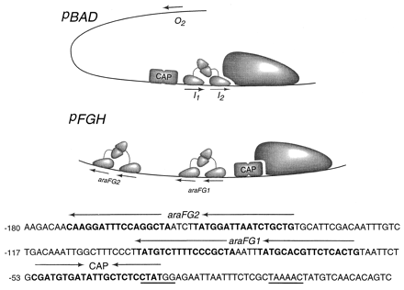
Where activators and repressors bind
Activators often partially overlap the 5’ end of a weak -35 site
Repressors can be pretty much anywhere
Notes:
Here is the DNA sequence of the Pbad promoter that responds to arabinose. *click* In blue we have the -35 box, and overlapping this sequence we have a *click* CAP binding site. This configuration in which an activator binds just upstream of and partially overlapping the -35 box is typical. Additionally, we have AraC binding sites at various places which similarly typical. When they physically occlude sigma factor binding, they do so usually by overlapping the -10 box, but it is common to see repressor-binding sites as far as 300 bp in either direction from the transcriptional start site.
AraC represents one class of transcription factor in which there is one polypeptide that binds to DNA and also binds to a small molecule.

Slide 25
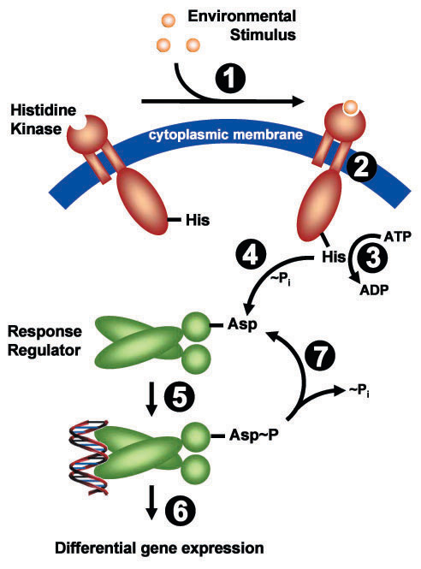
Two-component signal transduction
Two component systems split the sensing and DNA binding portions of a transcription factor into 2 (or more) proteins linked through a phosphorylation cascade
E. coli has 24 of these
Shewanella has 88 (16199584)
Environmental bacteria (soil and water) often have far more of these systems than pathogenic/commensal bacteria
Notes:
Another class of transcription factors split the sensing and DNA binding portions of the transcription factor into 2 proteins that interact through phosphorylation. One component, the histidine kinase binds ATP and can transfer the gamma phosphate it to the Response Regulator. The response regulator in turn binds to DNA in a way that depends on its phosphorylation state. Whether or not the histidine kinase does this phosphorylation reaction or not depends on some stimulus, such as the binding to a small molecule or ion. E. coli encodes 24 of these systems natively, but other prokaryotes often have far more. For example, the soil bacterium Shewanella has 88 of them. In general, Environmental bacteria have more need to respond to the external world than do pathogenic or commensal bacteria, and as a result have more transcription factors such as these.

Slide 26
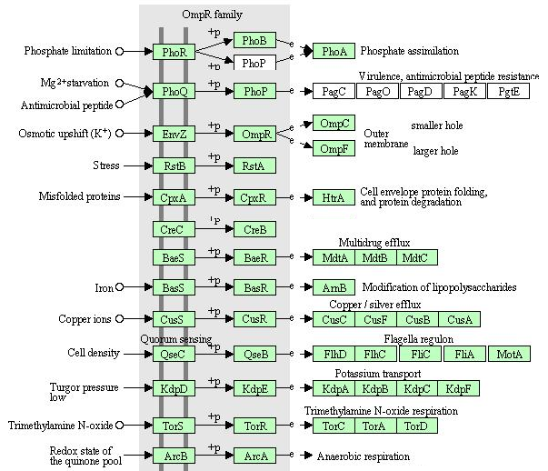
Two-component signal transduction
Salmonella Virulence Factors
Notes:
This figure shows the different two-component systems in E. coli and Salmonella. They are largely conserved across the enterobacteria. They respond to various specific ions such as phosphate, magnesium, and iron, but also more abstract things like envelope stress and osmotic upshifts. Many two component systems respond to specific redox species such as quinone. In response to these stimuli, each two component system regulates the promoters of many genes. A small number of regulated genes is illustrated in this slide, but the number of actual targets is far higher. In native promoters, it is very common to find many operators for response regulators that are not intuitively related to the original stimulus in an obvious way. For example, flagellar expression is regulated by cell density.

Slide 27
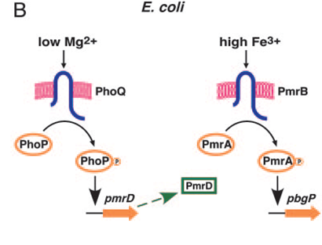
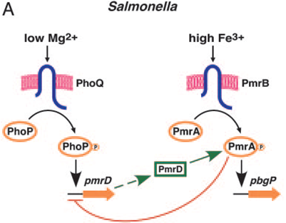
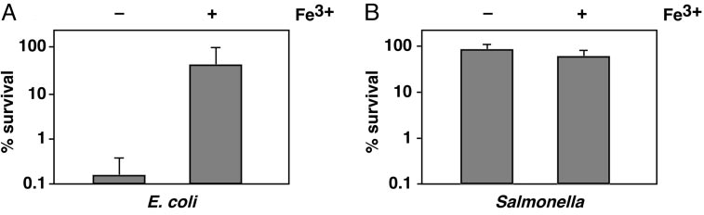
Differences in Fe³⁺/Mg²⁺ crosstalk
PmrA-activated pbgP gene and polymyxin B resistance
PMID 15569938
Notes:
Though genetically the regulatory machinery of bacteria all look very similar, the devil is in the details. E. coli and Salmonella have all the same orthogologs of these transcription factors, but subtle differences in wiring can give rise to different gene expression. In this example, we consider the regulation of the pbgP and pmrD genes. In E. coli, the phoPQ system regulates pmrD in response to magnesium ion, and the pmrAB system regulates pbgP in response to iron. However, in Salmonella, the pmrD gene also regulates pmrA and pmrA inhibits transcription of pmrD. This all boils down to subtle base pair differences in the promoters, but single mutations in the right place of a promoter can have profound affects on gene expression. In this case, the expression of pbgP in response to exogenous ions is quite different between the two organisms as a result of this slight change in genetic wiring.

Slide 28
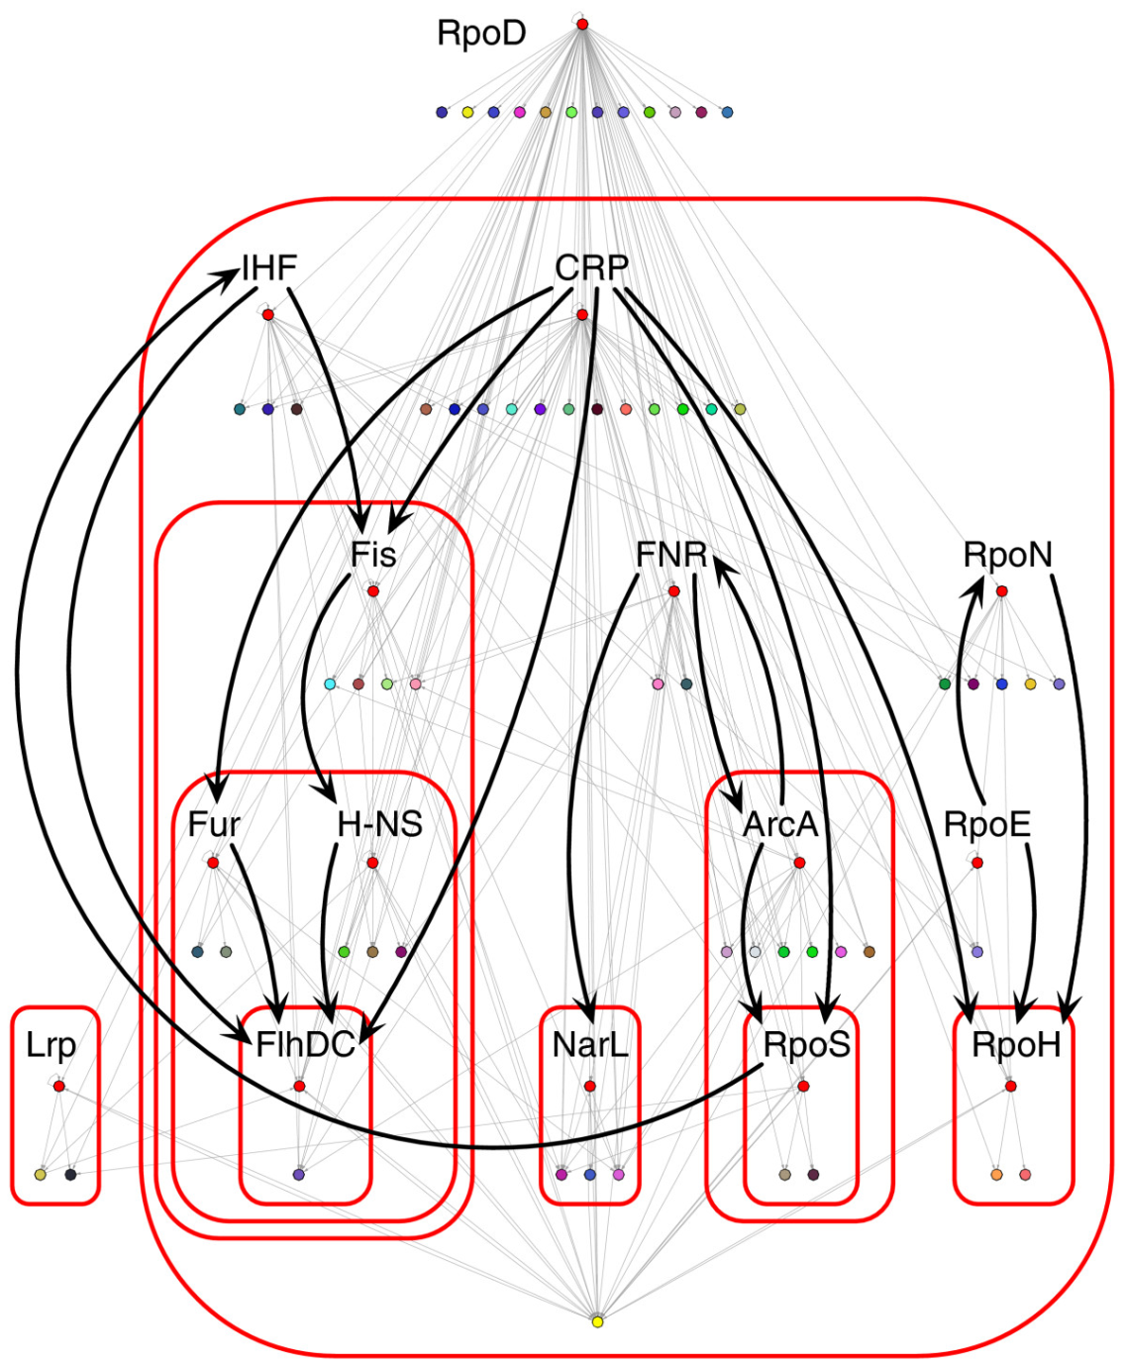
Specialized versus global regulators
Some TF/HKs are dedicated to a very specific response for a specific set of genes—ie lacR, AraC
Those tend to be encoded within the gene clusters they regulate
Others like CRP (glucose), LRP (leucine), fur (iron), cpx (envelope stess) are global TFs responding to a specific stimulus but regulate many promoters (pleiotropic)
Others still (IHF, Fis, H-NS) often bind promoters and play roles in changing the conformation of the DNA, but don’t respond to anything
Notes:
In terms of sequence homology, there are multiple classes of transcription factor. We’ve mentioned the AraC and two-component classes, but there are a few others. Another way of distinguishing the transcription factors is whether they regulate just one set of genes or many genes. Ultimately, this is not necessarily a property of the molecule but more of its role within the cell. Some transcription factors, like lacR and araC, respond to very specific chemical stimuli (lactose and arabinose availability) and in response control a specific set of genes associated with degrading those chemicals. In those cases, the transcription factors tend to be included in the gene clusters associated with the processes they control. There are also a number of pleiotropic transcription factors like CRP which responds to glucose and other preferred sugars, LRP which responds to the hydrophobic amino acids like leucine, fur which responds to iron, and so forth. In some cases, the stimuli is something specific, but there may be 100’s of genes that respond to these stimuli. In other cases, the stimuli is something more abstract like envelope stress. Additional pleiotropic transcription factors such as IHF, Fis, and H-NS don’t respond to specific stimuli, but are important in changing the conformation of the DNA and thus play critical roles in regulatory processes in the sense that they are necessary for proper function.

Slide 29
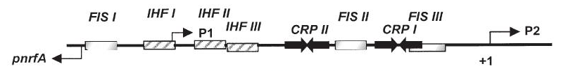
Complex Promoters
Some promoters are easy to understand by inspection of footprinting data—they only have a repressor an activator, or one of each
Complex promoters can contain multiple binding sites for a TF/HK, multiple TF/HK sites, incorporation of bending proteins like H-NS, methylation-dependent TF/HK binding, and multiple -10/-35 sites
It is unrealistic to think of promoters as modular composites of operator elements – even simple promoters are usually reticent to modular design (but libraries work)
Entire promoter regions can often be used as modular parts that retain their transcription profile
acs regulatory region (PMID: 14651625)
Notes:
There is a type of experiment called footprinting in which you can map out where a given transcription factor binds to a DNA, and that is how we get this sort of information that allows us to draw these diagrams.
*
Sometimes there really is just one repressor or activator over an otherwise normal promoter. However, many operons in bacteria have many operator sites and thus integrate many cellular signals together as a sort of logic gate.
*
When you look at one of these complex promoters, it is tempting to think of them simply. Though operators often have sequence identity and are readily identifiable within a sequence, that does not imply that they are compositionally modular. If you just place a bunch of operators together in a sequence randomly and ask whether you get complex behavior out, usually the answer is no. There are precise geometries involved the organization of these operators and binding proteins that currently are not understood. Thus, promoter engineering right now can only be done using large combinatorial libraries and is highly unpredictable.
*
However, entire promoter regions can often be used as modular parts, and they typically will retain their native transcriptional profile in a new genetic context.

Slide 30
Why transcriptional control?
Notes:
We’ve already talked about why you might want to use an inducible promoter, but nature uses promoters in more nuanced ways than this. Incorporation of these regulation mechanisms into genetic devices is current topic of study.

Slide 31
It’s useful for:
Environmental regulation
Timing
Negative feedback
Phase variation
Notes:
I’ll describe four of them: environmental regulation, timing, negative feedback, and phase variation.

Slide 32
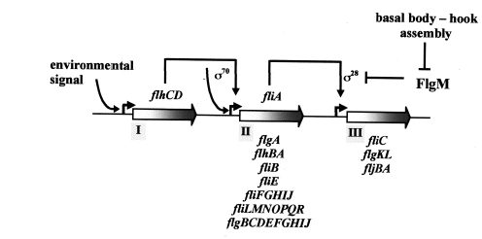
Environmental Control: Flagella
PMID 11104815
Notes:
Our inducible promoters are examples of environmental sensing. However, we use them in artificial context. For example, we regulate genes with arabinose in contexts where arabinose plays no other role in the system. In the native context, the promoter is sensing arabinose because it is deciding whether it needs to produce the genes to degrade this chemical. In this example, we show the complex promoter of flagella. Initiation of flagellar biosynthesis begins with an environmental signal.

Slide 33
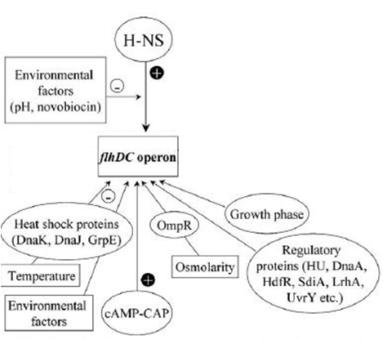
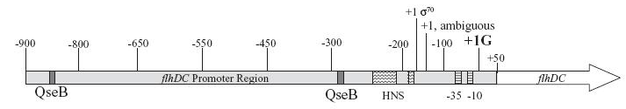
Environmental Control: Flagella
Activation of rest of flagellar genes
Notes:
All this environmental information is integrated through a single complex promoter controlling the flhD and flhC genes. Those in turn activate the rest of the flagellar genes. Inside that complex promoter are operators for many of the pleiotropic transcription factors. As a result, one cannot easily encapsulate the stimulus that this promoter responds to it. It is some combination of many factors. It is not a trivial signal like the presence or absense of one chemical. For example, it has a CAP binding site that ultimately responds to glucose availability, and it has an OmpR binding site responding to osmolarity. The promoter integrates this information, and for some of those combinatorial microstates transcription results. Presumably the integration of this set of cues allows the cell to make an intelligent decision about whether it is appropriate to stay in the same place or find a more nutritious environment.

Slide 34
Just-in-time Regulatory Cascades
PMID 11104815
Notes:
The second type of regulation is timing. This is usually observed for operons encoding proteins that form large protein complexes. Usually the formation of these complexes is not under thermodynamic control, and if you express the proteins in the wrong order they simply aggregate and get degraded. In the case of flagella, there is a large proteinaceous appendage on the surface of the cell composed of multiple proteins, and it needs to make them in the correct order. In this example, the timing is achieved using a transcriptional relay. Once the environmental conditions appropriate for flagellar production are reached, the flhCD genes initiate transcription of the second operon. One protein encoded by that operon is the fliA gene, which activates transcription of the third operon.
*click*
I’ve labeled several genes in blue, red, and green which encode individual proteins for the three phases of the relay. If you follow the production of these proteins over time after application of the environmental signal

Slide 35
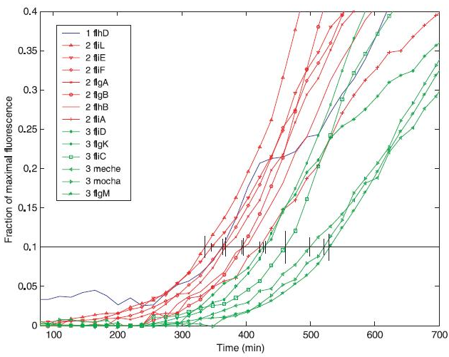
Just-in-time Regulatory Cascades
PMID 11408658
Notes:
You see something like this. FlhCD accumulates slowly, but the two downstream operons get expressed in two successive waves.

Slide 36
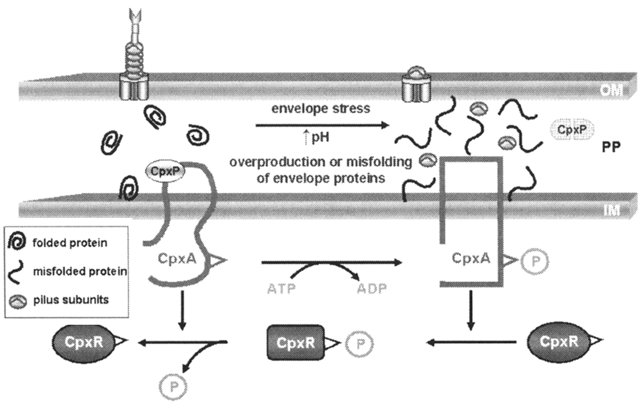
Feedback Regulation: cpxR and σ_{E}
Yersinia T3SS (PMID 17517869 )
LEE (PMID 18227171)
Bundle-forming pili (PMID 15629938 )
P pili (PMID 15546614)
Porin ompC (PMID 16077119)
Flagella (PMID 10542180)
degP, cpxP
(periplasmic proteases)
Notes:
Another common use of transcriptional control is negative feedback. Most promoters that control outer membrane proteins will be hooked into the envelope stress pathways of the cell. Here we are looking at one of these stress responses called Cpx. This pleotropic two-component system involves three proteins: cpxR, cpxA, and cpxP. CpxA is the histidine kinase, and cpxR is the response regulator. CpxP is a peptide probe expressed in the periplasm that binds to and represses the kinase. When there is little membrane stress, cpxP folds normally and then binds to cpxA. However, if there is stress, misfolded proteins will accumulate, and cpxP is one protein that is particularly sensitive to such stress. If the cpxP aggregates, it will no longer interact with cpxA, and the kinase begins phosphorylating cpxR. This response regulator then goes on to either upregulate or down regulate many genes. It will *click* upregulate proteases that help clean up the misfolded protein, and it will *click* downregulate genes encoding outer membrane proteins. As a result, a steady state is achieved in which no more membrane-targeted protein is generated than the membrane can handle.

Slide 37
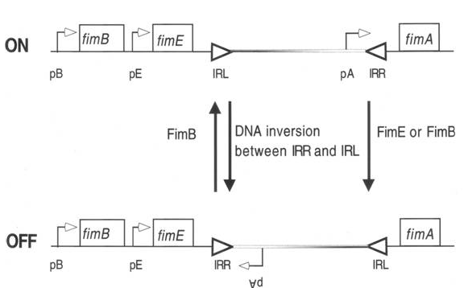
Phase variation
Promoters are single copy
Results in heterogeneity
Often used to escap immune responses
Common in pili regulation
PMID 15546614
Notes:
Finally, we have phase variation.
Since promoters typically exist as a single molecule in the cell, different cells might exhibit different states of the same promoter. It is a stochastic system, so the population of microstates does not average out within one cell.
The result is population heterogeneity in which different cells are doing different things
Phase variation is most often seen in the regulation of genes that are surface displayed and elicit immune responses. Thus, such mechanisms are most common in pathogenic or commensal bacteria.
Most well-studied examples deal with the regulation of pili, which are proteinaceous appendages to the cell that enable them to bind to host cells. In this example, we illustrate one of the best studied systems for regulation of P pili biosythesis called the fim operon. There are many mechanisms by which phase variation is achieved, but this one is quite simple: The DNA is physically inverted by means of a site-specific DNA recombinase called fimB. In one orientation, the promoter points towards fimA and the rest of the biosynthetic genes. In the other orientation it is pointed in the other direction. Thus, it represents a boolean switch resulting in all-or-none production of pili.

